Slide 1
INFO 6210 FINAL
Tianyu Zhong

Slide 2
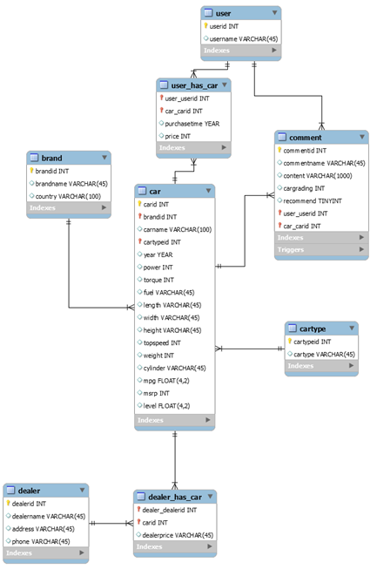
ER Diagram

Slide 3
Create, insert DB and tables
CREATE schema:
DROP SCHEMA IF EXISTS `mydb` ;
CREATE SCHEMA IF NOT EXISTS `mydb` DEFAULT CHARACTER SET utf8 ;
USE `mydb` ;
DROP TABLE IF EXISTS `brand` ; CREATE TABLE IF NOT EXISTS `brand` ( `brandid` INT NOT NULL, `brandname` VARCHAR(45) NULL, `country` VARCHAR(100) NULL, PRIMARY KEY (`brandid`)) ENGINE = InnoDB;

Slide 4
Create, insert DB and tables
DROP TABLE IF EXISTS `cartype` ; CREATE TABLE IF NOT EXISTS `cartype` ( `cartypeid` INT NOT NULL, `cartype` VARCHAR(45) NULL, PRIMARY KEY (`cartypeid`)) ENGINE = InnoDB;
DROP TABLE IF EXISTS `dealer` ; CREATE TABLE IF NOT EXISTS `dealer` ( `dealerid` INT NOT NULL, `dealername` VARCHAR(45) NULL, `address` VARCHAR(45) NULL, `phone` VARCHAR(45) NULL, PRIMARY KEY (`dealerid`)) ENGINE = InnoDB;

Slide 5
Create, insert DB and tables
DROP TABLE IF EXISTS `user` ; CREATE TABLE IF NOT EXISTS `user` ( `userid` INT NOT NULL, `username` VARCHAR(45) NULL, PRIMARY KEY (`userid`)) ENGINE = InnoDB;
DROP TABLE IF EXISTS `comlog` ; CREATE TABLE IF NOT EXISTS `comlog` ( `comlogid` INT NOT NULL AUTO_INCREMENT, `commentid` INT NULL, `comname` VARCHAR(100) NULL, `cont` VARCHAR(1000) NULL, `grd` INT NULL, `rcm` TINYINT NULL, `action` VARCHAR(45) NULL, `changedate` DATETIME NULL, PRIMARY KEY (`comlogid`)) ENGINE = InnoDB;

Slide 6
Create, insert DB and tables
DROP TABLE IF EXISTS `comment` ; CREATE TABLE IF NOT EXISTS `comment` ( `commentid` INT NOT NULL AUTO_INCREMENT, `commentname` VARCHAR(45) NULL, `content` VARCHAR(1000) NULL, `cargrading` INT NULL, `recommend` TINYINT NULL, `user_userid` INT NOT NULL, `car_carid` INT NOT NULL, PRIMARY KEY (`commentid`, `user_userid`, `car_carid`),
INDEX `fk_comment_user1_idx` (`user_userid` ASC), INDEX `fk_comment_car1_idx` (`car_carid` ASC), CONSTRAINT `fk_comment_user1` FOREIGN KEY (`user_userid`) REFERENCES `user` (`userid`) ON DELETE NO ACTION ON UPDATE NO ACTION, CONSTRAINT `fk_comment_car1` FOREIGN KEY (`car_carid`) REFERENCES `car` (`carid`) ON DELETE NO ACTION ON UPDATE NO ACTION) ENGINE = InnoDB;

Slide 7
Create, insert DB and tables
DROP TABLE IF EXISTS `user_has_car` ; CREATE TABLE IF NOT EXISTS `user_has_car` ( `user_userid` INT NOT NULL, `car_carid` INT NOT NULL, `purchasetime` YEAR NULL, `price` INT NULL, PRIMARY KEY (`user_userid`, `car_carid`), INDEX `fk_user_has_car_car1_idx` (`car_carid` ASC), INDEX `fk_user_has_car_user1_idx` (`user_userid` ASC),
CONSTRAINT `fk_user_has_car_user1` FOREIGN KEY (`user_userid`) REFERENCES `user` (`userid`) ON DELETE NO ACTION ON UPDATE NO ACTION, CONSTRAINT `fk_user_has_car_car1` FOREIGN KEY (`car_carid`) REFERENCES `car` (`carid`) ON DELETE NO ACTION ON UPDATE NO ACTION) ENGINE = InnoDB;

Slide 8
Create, insert DB and tables
DROP TABLE IF EXISTS `dealer_has_car` ; CREATE TABLE IF NOT EXISTS `dealer_has_car` ( `dealer_dealerid` INT NOT NULL, `carid` INT NOT NULL, `dealerprice` VARCHAR(45) NULL, PRIMARY KEY (`dealer_dealerid`, `carid`), INDEX `fk_dealer_has_car_car1_idx` (`carid` ASC), INDEX `fk_dealer_has_car_dealer1_idx` (`dealer_dealerid` ASC),
CONSTRAINT `fk_dealer_has_car_dealer1` FOREIGN KEY (`dealer_dealerid`) REFERENCES `dealer` (`dealerid`) ON DELETE NO ACTION ON UPDATE NO ACTION, CONSTRAINT `fk_dealer_has_car_car1` FOREIGN KEY (`carid`) REFERENCES `car` (`carid`) ON DELETE NO ACTION ON UPDATE NO ACTION) ENGINE = InnoDB;

Slide 9
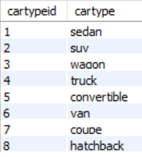
Create, insert DB and tables
INSERT INTO `cartype` (`cartypeid`, `cartype`) VALUES (1, 'sedan'); INSERT INTO `cartype` (`cartypeid`, `cartype`) VALUES (2, 'suv'); INSERT INTO `cartype` (`cartypeid`, `cartype`) VALUES (3, 'wagon'); INSERT INTO `cartype` (`cartypeid`, `cartype`) VALUES (4, 'truck'); INSERT INTO `cartype` (`cartypeid`, `cartype`) VALUES (5, 'convertible'); INSERT INTO `cartype` (`cartypeid`, `cartype`) VALUES (6, 'van'); INSERT INTO `cartype` (`cartypeid`, `cartype`) VALUES (7, 'coupe'); INSERT INTO `cartype` (`cartypeid`, `cartype`) VALUES (8, 'hatchback');

Slide 10
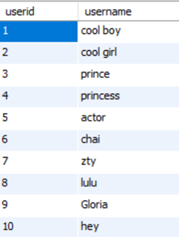
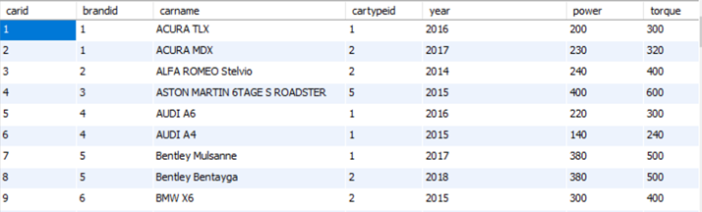
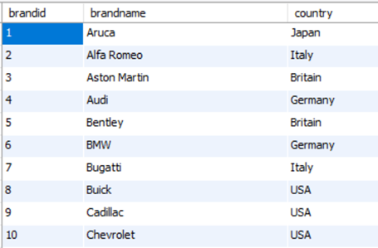
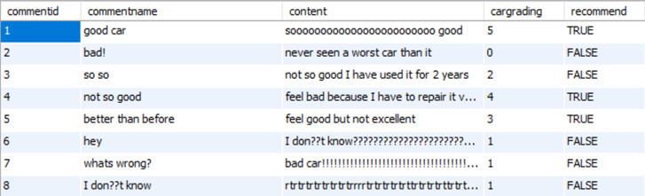

Slide 11
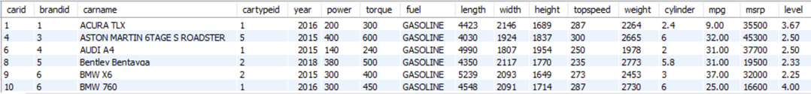
Query
# select cars that the msrp is lower than 50000 SELECT * FROM car WHERE msrp < 50000;

Slide 12
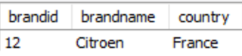
Query
# select brand that whose car has the lowest msrp SELECT * FROM brand WHERE brandid = (SELECT brandid FROM car WHERE msrp = (SELECT MIN(msrp) FROM car));

Slide 13
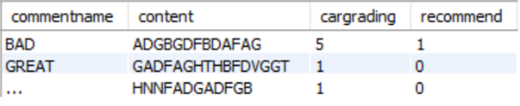
Query
# select comment for porsche cayanne SELECT commentname, content, cargrading, recommend FROM comment WHERE car_carid IN (SELECT carid FROM car WHERE carname LIKE '%Cayenne%');

Slide 14
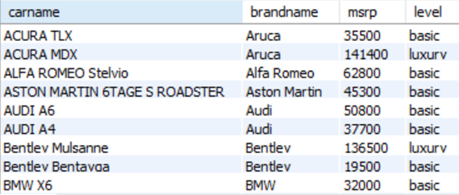
Query
# if msrp is greater than 10000, define level as luxury SELECT carname, brandname, msrp, IF(msrp > 100000, 'luxury', 'basic') AS level FROM car c INNER JOIN brand b ON b.brandid = c.brandid;

Slide 15
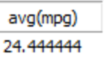
Query
#find the average mpg of suv SELECT AVG(mpg) FROM car WHERE cartypeid = (SELECT cartypeid FROM cartype WHERE cartype = 'SUV');

Slide 16
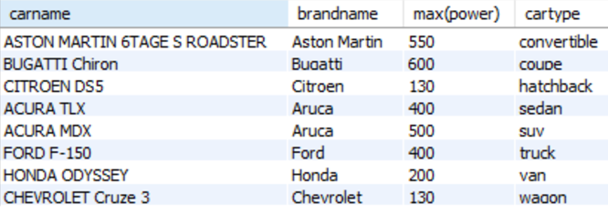
Query
#find the car with max power for every type of car SELECT carname, brandname, MAX(power), cartype FROM car c INNER JOIN cartype ct ON c.cartypeid = ct.cartypeid INNER JOIN brand b ON c.brandid = b.brandid GROUP BY cartype;

Slide 17
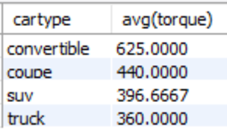
Query
#find the type of car with average of torque over 300 SELECT cartype, AVG(torque) FROM car c INNER JOIN cartype ct ON c.cartypeid = ct.cartypeid GROUP BY cartype HAVING AVG(torque) > 300;

Slide 18

Query
#find the most discount and the cordinate car information SELECT dealername, dealerprice, carname, MAX(100 * (msrp - dealerprice) / msrp) FROM dealer d INNER JOIN dealer_has_car dhc ON d.dealerid = dhc.dealer_dealerid INNER JOIN car c ON dhc.carid = c.carid;

Slide 19
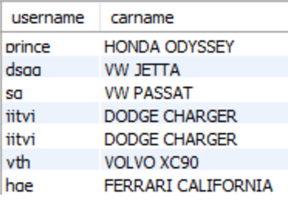
Query
#find user who commented cars that they have SELECT username, carname FROM user u INNER JOIN user_has_car uhc ON u.userid = uhc.user_userid INNER JOIN comment c ON u.userid = c.user_userid INNER JOIN car ON car.carid = uhc.car_carid WHERE uhc.car_carid = c.car_carid;

Slide 20
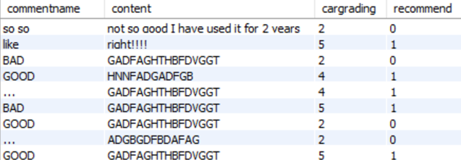
Query
#find all comment about SUV SELECT commentname, content, cargrading, recommend FROM comment WHERE car_carid IN (SELECT carid FROM car WHERE cartypeid = (SELECT cartypeid FROM cartype WHERE cartype = 'SUV'));

Slide 21
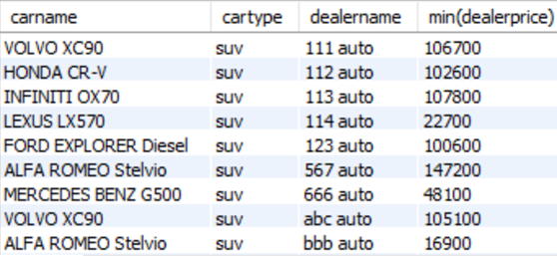
Query
# find the cheapest suv for every dealer SELECT carname, cartype, dealername, MIN(dealerprice) FROM dealer d INNER JOIN dealer_has_car dhc ON d.dealerid = dhc.dealer_dealerid INNER JOIN car c ON c.carid = dhc.carid INNER JOIN cartype ct ON c.cartypeid = ct.cartypeid WHERE cartype = 'SUV' GROUP BY dealername;

Slide 22
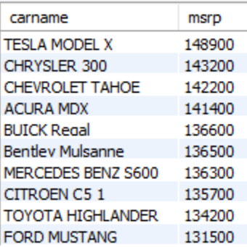
Query
# find first 10 cars that have the largest msrp SELECT carname, msrp FROM car ORDER BY msrp DESC LIMIT 10;

Slide 23
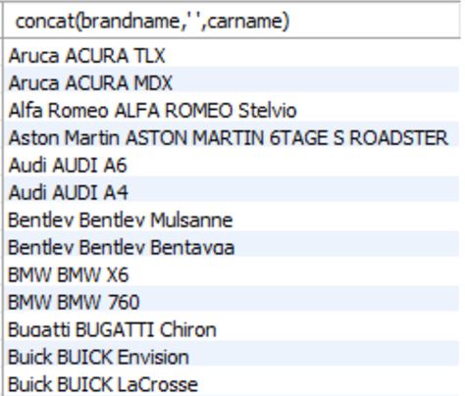
Query
#concatencate the brand name and car name SELECT CONCAT(brandname, ' ', carname) FROM brand b INNER JOIN car c ON b.brandid = c.brandid;

Slide 24
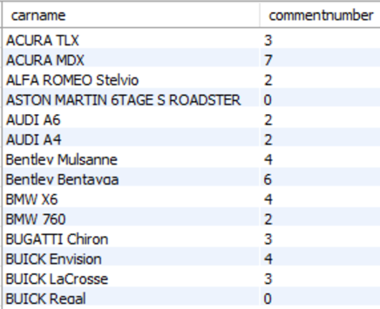
Query
#find the number of comment for every car SELECT carname, COUNT(car_carid) FROM car c LEFT JOIN comment com ON c.carid = com.car_carid GROUP BY carid;

Slide 25
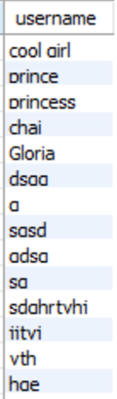
Query
#find users whose pruchase price of car is less than dealer price SELECT DISTINCT username FROM user u LEFT JOIN user_has_car uhc ON u.userid = uhc.user_userid LEFT JOIN car c ON uhc.car_carid = c.carid LEFT JOIN dealer_has_car dhc ON c.carid = c.carid WHERE uhc.price < dhc.dealerprice;

Slide 26
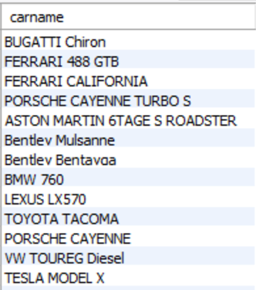
Query
#find cars with power over 400 or torque over 400 (SELECT carname FROM car WHERE power > 400) UNION (SELECT carname FROM car WHERE torque > 400)

Slide 27
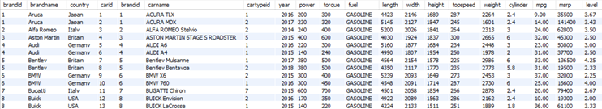
Query
#full join of brand and car (SELECT * FROM brand LEFT JOIN car ON brand.brandid = car.brandid) UNION (SELECT * FROM brand RIGHT JOIN car ON brand.brandid = car.brandid)

Slide 28
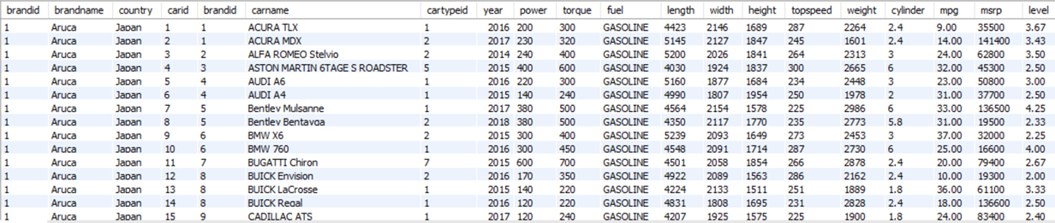
Query
#cross join example SELECT * FROM brand CROSS JOIN car;

Slide 29
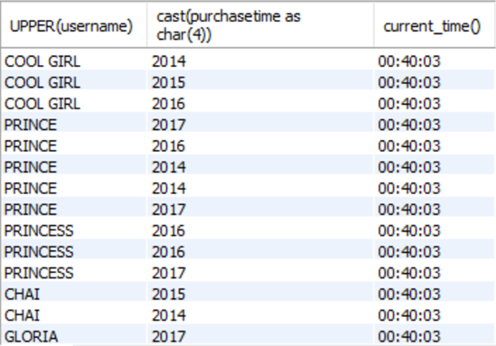
Query
#string and date/year manipualtion SELECT UPPER(username), CAST(purchasetime AS CHAR (4)), CURRENT_TIME() FROM user u INNER JOIN user_has_car uhc WHERE u.userid = uhc.user_userid;

Slide 30
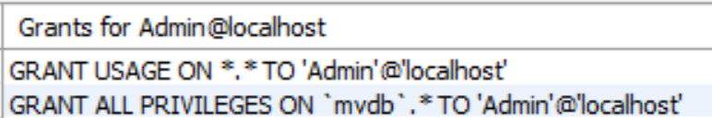
Privilege
Drop User 'Admin'@'localhost';
Create User 'Admin'@'localhost' identified By 'admin';
grant all on `mydb`.* to 'Admin'@'localhost';
flush privileges;
show grants for 'Admin'@'localhost';
‘Admin’ can do everything in the database. This user has all privileges including alter, update, select, insert, etc.

Slide 31

Privilege
Drop User 'Developer'@'localhost';
Create User 'Developer'@'localhost' identified By'deve';
Grant Select,insert,update,delete,show view,trigger,references,alter on `mydb`.* to 'Developer'@'localhost';
flush privileges;
show grants for 'Developer'@'localhost';
‘Developer’ can select,insert,update,delete,show view,trigger,references,alter all tables in the database.

Slide 32
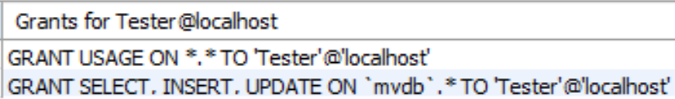
Privilege
Drop User 'Tester'@'localhost';
Create user 'Tester'@'localhost' identified by 'test';
GRANT select,insert,update on `mydb`.* to 'Tester'@'localhost';
flush privileges;
Give ‘Tester’ privilege of select, insert, update on all tables in the database

Slide 33
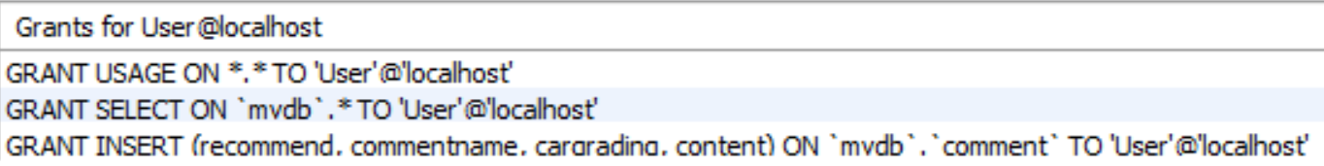
Privilege
Drop User 'User'@'localhost';
Create user 'User'@'localhost' identified by 'us';
GRANT select on `mydb`.* to 'User'@'localhost';
flush privileges;
GRANT insert(commentname,content,cargrading,recommend) on `mydb`.comment to 'User'@'localhost';
flush privileges;
show grants for 'User'@'localhost';
Give ‘User’ privilege of select on all tables of database;
Give ‘User’ privilege of insert on some columns of table ‘comment’.

Slide 34
Stored Procedure
DROP PROCEDURE IF EXISTS addcomment; DELIMITER // CREATE PROCEDURE addcomment( IN userid int, IN carid int, IN name VARCHAR(100), IN text VARCHAR(1000), IN grade int, IN rec BOOLEAN) BEGIN insert comment(commentname,content,cargrading, recommend,user_userid,car_carid) values(name,text,grade,rec,userid,carid); END// DELIMITER ;
The stored procedure is designed for adding comment into the database. CALL addcomment(2,43,'325435','43654634gvegrfgf',5,True)

Slide 35
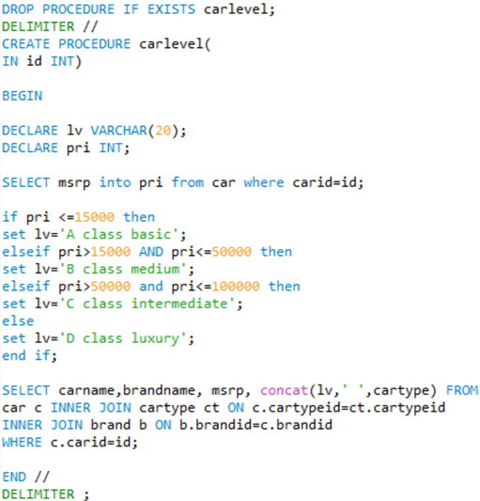

Stored Procedure
The stored procedure is designed for display the car level that is defined based on price(msrp). CALL carlevel(4);

Slide 36
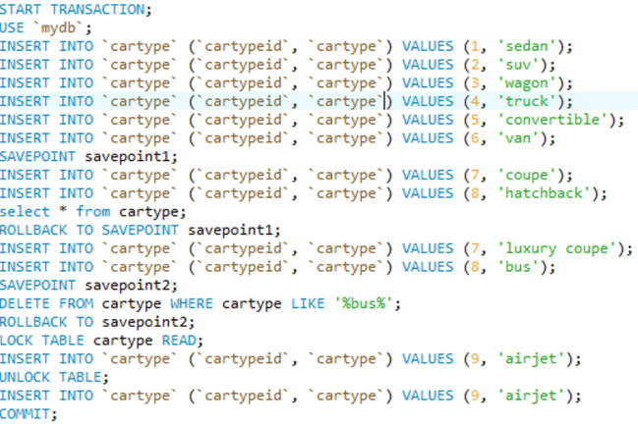

Transaction
Insert values into table with transaction. Two savepoints are set in the code. If one table is locked, values cannot be inserted.

Slide 37

Triggers
CREATE DEFINER = CURRENT_USER TRIGGER `mydb`.`comment_BEFORE_INSERT` BEFORE INSERT ON `comment`
FOR EACH ROW BEGIN if new.cargrading<0 or new.cargrading>5 THEN SIGNAL SQLSTATE VALUE '45000' SET MESSAGE_TEXT = 'Invalid grade!'; end if; END
If an invalid value want to insert, error will be reported to user.

Slide 38
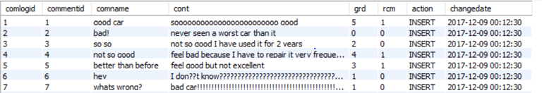
Trigger
CREATE DEFINER = CURRENT_USER TRIGGER `mydb`.`comment_AFTER_INSERT` AFTER INSERT ON `comment` FOR EACH ROW BEGIN insert into comlog set commentid=new.commentid, comname=new.commentname, cont=new.content, grd=new.cargrading, rcm=new.recommend, action='INSERT', changedate=now(); UPDATE car SET level = (SELECT AVG(cargrading) FROM comment WHERE car_carid = new.car_carid GROUP BY comment.car_carid) WHERE carid = new.car_carid; END
After new comment is inserted, the information will be documented in table ‘comlog’, and the level of car that user comments will be graded again, by calculating the average value.

Slide 39


Trigger
CREATE DEFINER = CURRENT_USER TRIGGER `mydb`.`comment_AFTER_DELETE` AFTER DELETE ON `comment` FOR EACH ROW BEGIN UPDATE car SET level = (SELECT AVG(cargrading) FROM comment WHERE car_carid = old.car_carid GROUP BY comment.car_carid) WHERE carid = old.car_carid; END
The level of car that user comments will be graded again after delete one comment in the table, by calculating the average value.
BEFORE DELETE
AFTER DELETE

Slide 40
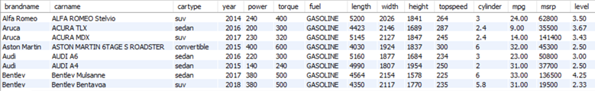
Views
CREATE VIEW carinfo AS SELECT Brandname, carname, cartype, year, power, torque, fuel, length, width, height, topspeed, cylinder, mpg, msrp, level FROM brand b LEFT JOIN car c ON b.brandid = c.brandid LEFT JOIN cartype ct ON c.cartypeid = ct.cartypeid ORDER BY brandname;

Slide 41
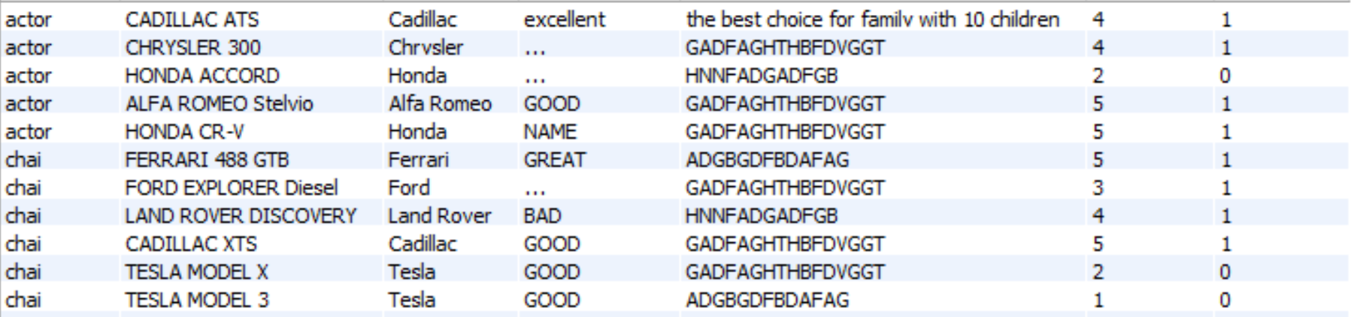
Views
CREATE VIEW commentinfo AS SELECT username,carname, brandname, commentname, content, cargrading, recommend FROM user u RIGHT JOIN comment com ON u.userid = com.user_userid LEFT JOIN car c ON com.car_carid = c.carid LEFT JOIN brand b ON c.brandid = b.brandid ORDER BY username;

Slide 42
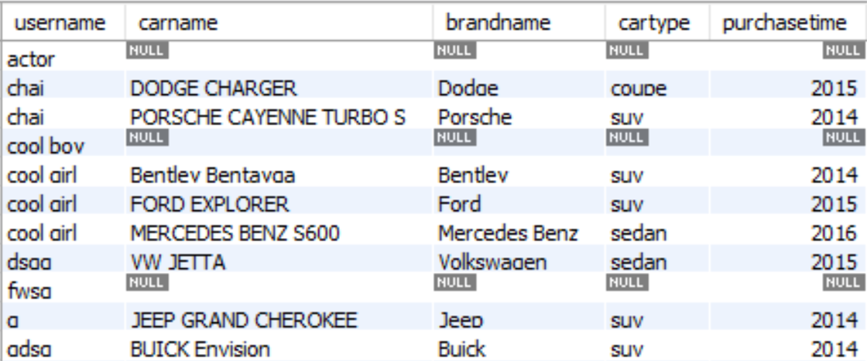
Views
CREATE VIEW userinfo AS SELECT username, carname, brandname, cartype, purchasetime FROM user u LEFT JOIN user_has_car uhc ON u.userid = uhc.user_userid LEFT JOIN car c ON uhc.car_carid = c.carid LEFT JOIN brand b ON b.brandid = c.brandid LEFT JOIN cartype ct ON c.cartypeid = ct.cartypeid ORDER BY username;

Slide 43
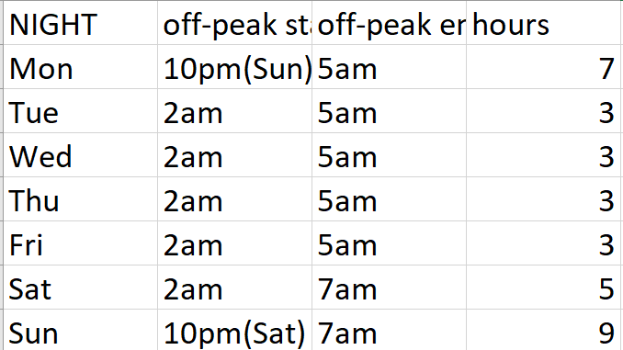
Backup
A full backup takes around 9 hours, whereas an incremental backup takes about 1 hour per day of changes that you want to include in the backup.
Making backups is not allowed during the peak usage hours of: 5:00am to 2:00am weekdays, and 7:00am to 10:00pm on weekends.

Slide 44
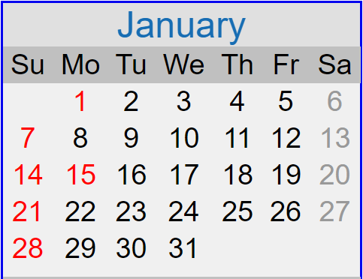
Backup
Mon: Incremental Backup from last Sunday
Tue: Incremental Backup from last Sunday
Wed: Incremental Backup from last Sunday
Thu :Incremental Backup from last Wednesday
Fri:Incremental Backup from last Wednesday
Sat:Incremental Backup from last Wednesday
Sun: Full backup

Slide 45
Backup
Jan. 7,14,21,28 for Full backup
Other days for incremental backup.

